Slide 1

Your past. Your present. Your future.
Notes:
I would like you to try and remember your happiest memory. Now, think about yourselves 40 years from now. You may no longer remember that moment. Wouldn’t you like to capture those moments and relive them in the future? That’s what Capsulefy is about.

Slide 2
OVERVIEW
Idea
Team
MVP
Viability study
Technologies
Competitors
Pilot users
Planification
Costs
Conclusions

Slide 3
IDEA

Slide 4





IDEA

Slide 5
IDEA
?
****

Slide 6
TEAM

Slide 7
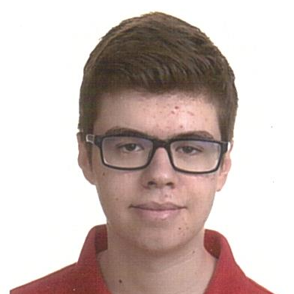



TEAM
Pablo Rebollo
Project manager, backend developer

Slide 8
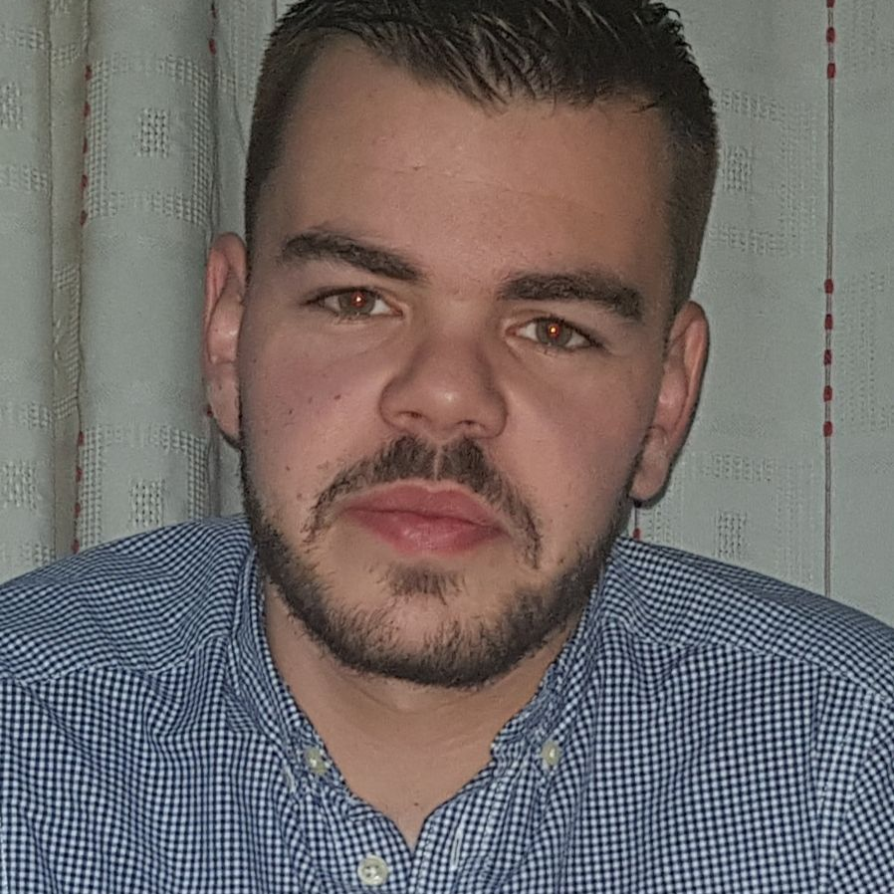


TEAM
Adrián Cantón
Business manager, full-stack developer

Slide 9


TEAM
Daniel Carpio
Analist, frontend developer

Slide 10


TEAM
Juan Rodríguez
Requirements engineer, backend developer

Slide 11


TEAM
Rafael Fresno
Backend developer, API integration

Slide 12




GOALS

Slide 13




KNOWLEDGE MANAGEMENT

Slide 14
MVP

Slide 15

CLASSIFICATION
=

Slide 16
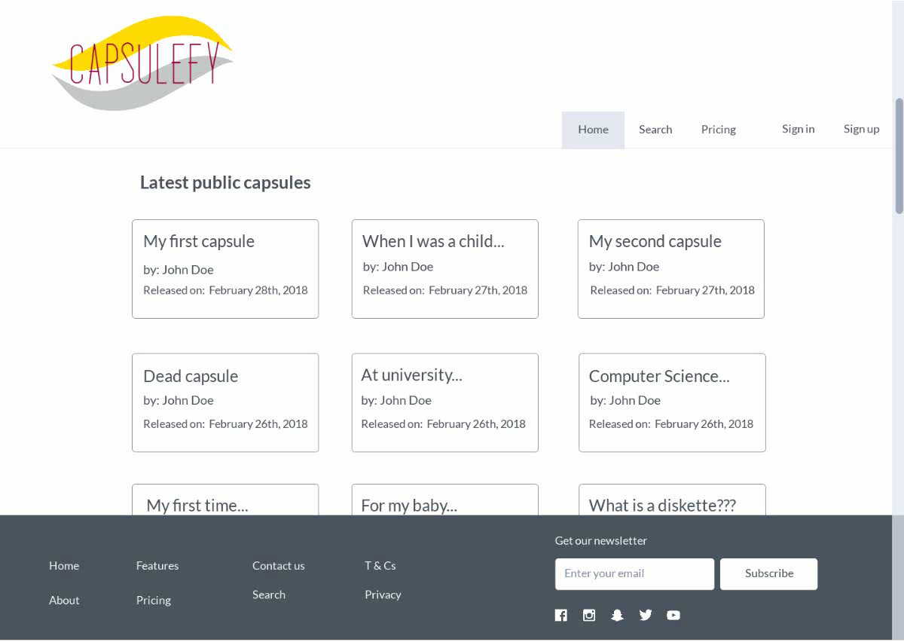
No logged user

Slide 17
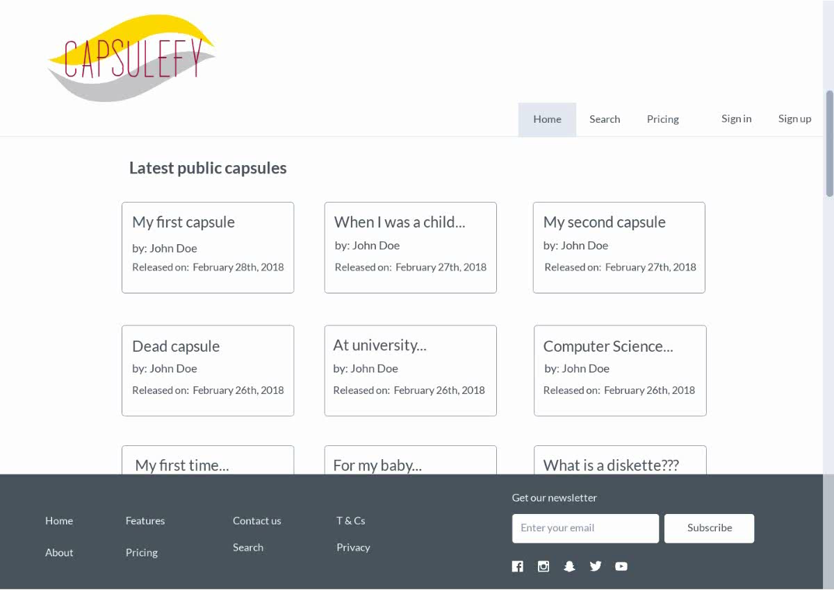
Logged-in user

Slide 18
VIABILITY STUDY

Slide 19
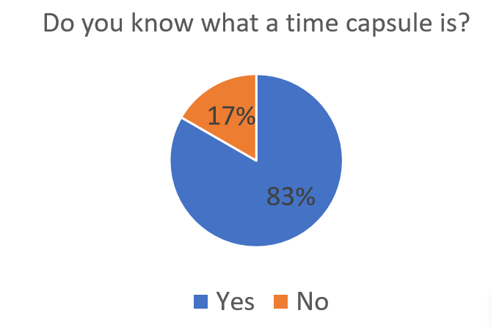
VIABILITY STUDY

Slide 20
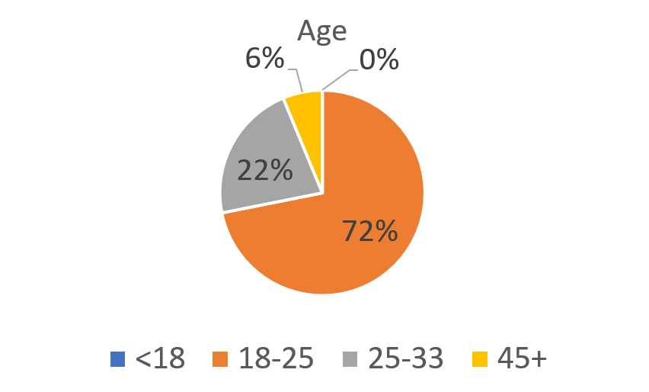
VIABILITY STUDY

Slide 21
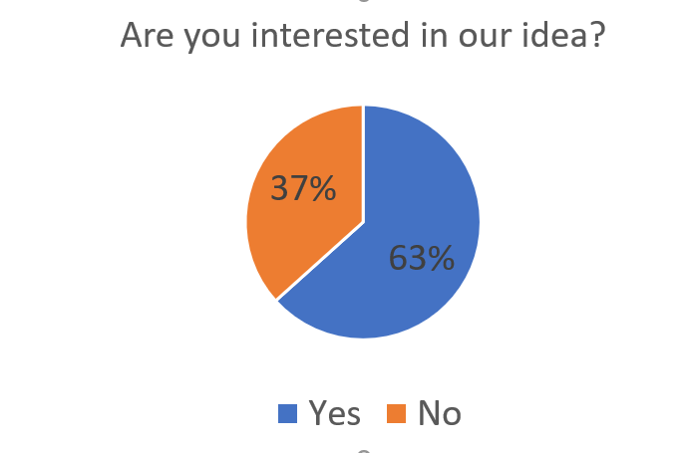
VIABILITY STUDY

Slide 22
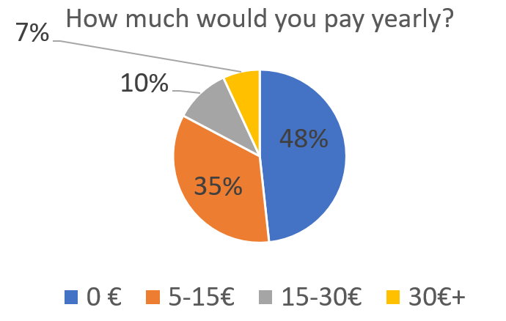
VIABILITY STUDY

Slide 23
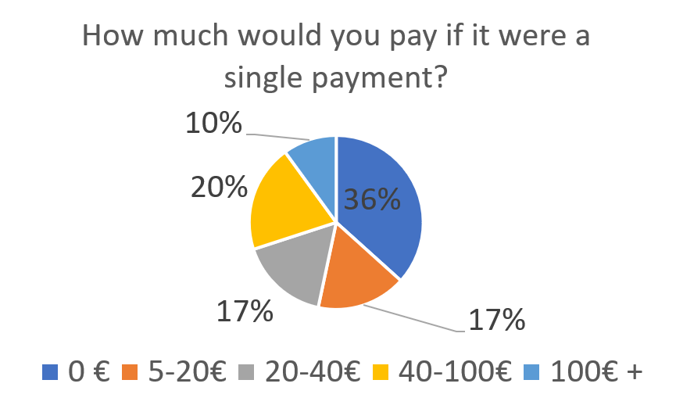
VIABILITY STUDY

Slide 24
TECHNOLOGIES

Slide 25





TECHNOLOGIES
Main web app
Users and capsules APIs
Social media APIs

Slide 26

TECHNOLOGIES
?

Slide 27



ALM

Slide 28
COMPETITORS

Slide 29


COMPETITORS
 | Viajeros en el tiempo | Mytimecapsule | Miigen | thetimecapsule | Capsulefy
Automatic content publication
Free version
Premium version
Images
Videos
Social network interaction
Dead man switch

Slide 30




SWOT MATRIX
STRENGTHS | WEAKNESSES
OPPORTUNITIES | THREATS

Slide 31
PILOT USERS

Slide 32
PILOT USERS
Francisco R.
Javier A.
Valentin A.
Antonio G.
José Manuel J.
Sandra C.
José Manuel D.

Slide 33


COMMITMENT

Slide 34
PAYMENT PLANS
 | Free | Premium
Price | 0 € | 10 €/year
Space | 10 MB/user | 100 MB/capsule
Social network and email integration
Capsule scheduling | Up to 1 year | Depends on subscription
Open capsule duration | 6 months | 1 year after subscription expiration
Duration extension

Slide 35

PLANIFICATION
Each week
Sprint planning
Send deliverable
Each deliverable

Slide 36
PLANIFICATION
First sprint | Core use cases Piloting plan
Second sprint | Full MVP Feedback taken into account
Third sprint | Polished MVP

Slide 37
FIRST SPRINT
- Prepare development environment
- Implement data models
- Work on requirements
- Test the system
- Take actions according to feedback

Slide 38
COSTS

Slide 39


COSTS
Realistic: 34348.71 – 43554.24 €
Optimistic: 27105.61 €
Pesimistic: 60474.63 €
Notes:
Factors taken into account: salaries, workplace, hosting, adversitement.

Slide 40
COSTS (REALISTIC 1)
Project duration | 4 months
Salaries (PM) | 30.50 €/hour
Salaries | 20.80 €/hour
Hours per month | 50
Equipment | 306.67 €
Hosting (1 year) | 526.56 €
Advertising (6 months) | 1800 €
Total | 34348.71 €

Slide 41
COSTS (REALISTIC 2)
Project duration | 5 months
Salaries (PM) | 30.50 €/hour
Salaries | 20.80 €/hour
Hours per month | 50
Equipment | 383.33 €
Hosting (1 year) | 526.56 €
Advertising (6 months) | 3000 €
Total | 43554.24 €

Slide 42
COSTS (OPTIMISTIC)
Project duration | 4 months
Salaries (PM) | 30.50 €/hour
Salaries | 20.80 €/hour
Hours per month | 40
Equipment | 306.67 €
Hosting (1 year) | 526.56 €
Advertising (6 months) | 900 €
Total | 27105.61 €

Slide 43
COSTS (PESIMISTIC)
Project duration | 6 months
Salaries (PM) | 30.50 €/hour
Salaries | 20.80 €/hour
Hours per month | 60
Equipment | 460 €
Hosting (1 year) | 526.56 €
Advertising (6 months) | 2400 €
Total | 60474.63 €

Slide 44




RISKS
Notes:
Computers not working, contracts changing, servers down, incompatible schedules, negative reception and losses.

Slide 45
CONCLUSIONS

Slide 46
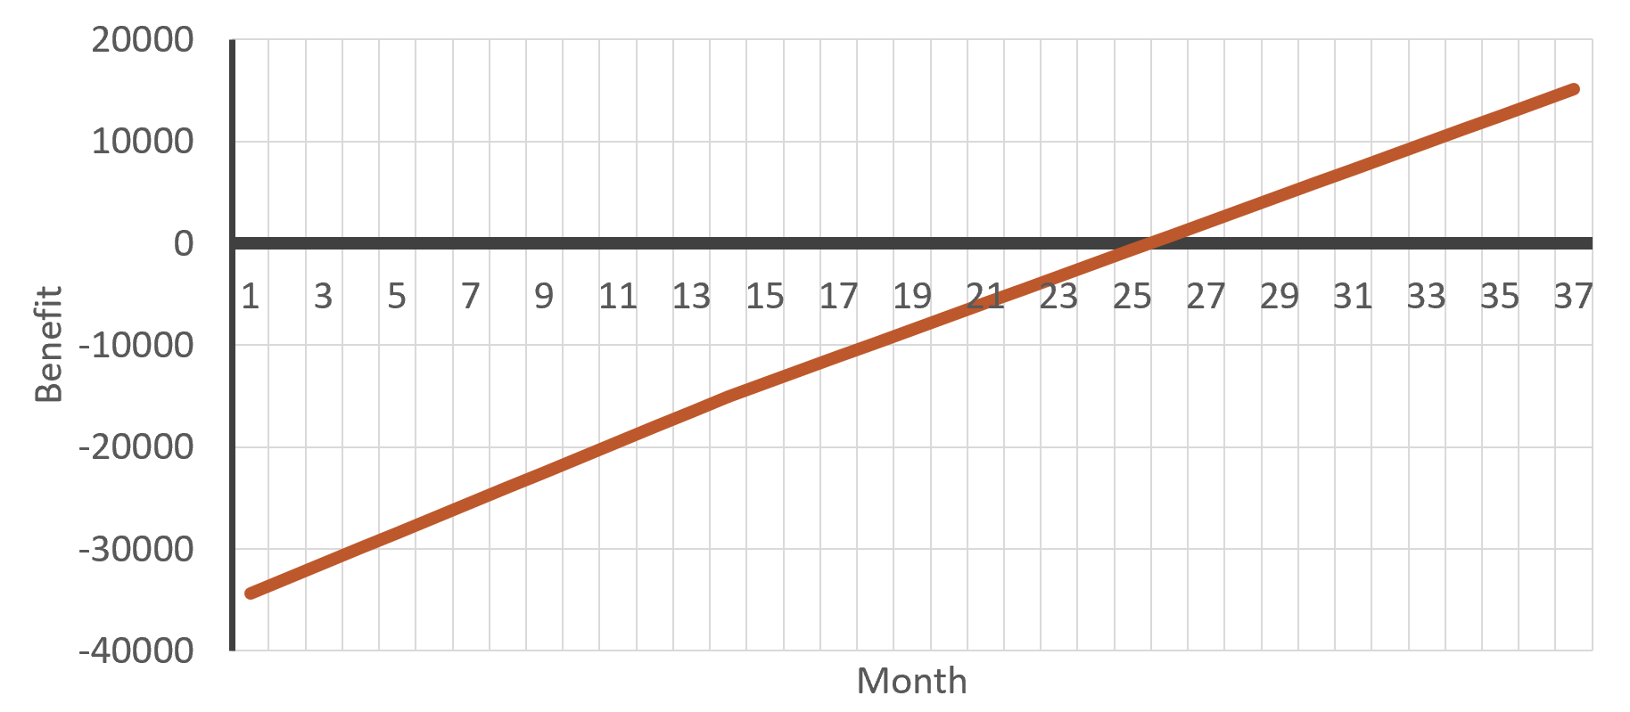
CONCLUSIONS

Slide 47
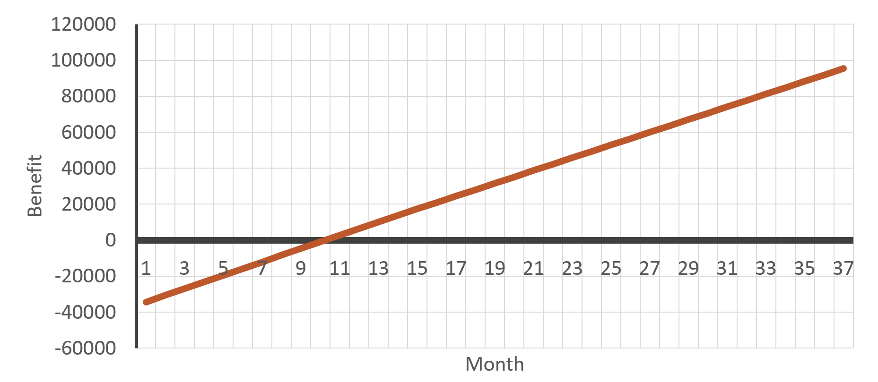
CONCLUSIONS

Slide 48
THANKS!
Capsulefy.communications@Gmail.com
Notes:
Insurance companies: offer capsules to their clients, with no expiration and special prices. Create endpoint for insurances to send their client data.

Slide 49

MOCKUPS
https://marvelapp.com/4395g15/screen/53795517

Slide 50

CORE USE CASES
Refresh deadman switch
Select type of capsule
<<includes>>
Unregistered user
Registered user
Pay for a
capsule

Slide 51
CORE USE CASES
Delete
capsule
Create free
capsule
Unregistered user
View
capsule
Registered user

